Slide 1
Understanding the Core Services of AWS

Slide 2

Overview
Elastic Compute Cloud (EC2)
Simple Storage Service (S3) Relational Database Service (RDS) Route 53

Slide 3
Elastic Compute Cloud

Slide 4

Elastic Compute Cloud (EC2)
The solution for your computing needs

Slide 5





What Can You Do with EC2?
Run Applications
Virtual Desktop
3rd Party Software
Computing!

Slide 6
Elastic Compute Cloud
ElasElastictic
Compute Cloud
Instances running computing operations can increase or decrease at will
Computing services operating in remote data servers around the world

Slide 7

Basic Unit of EC2
EC2 Instance

Slide 8
Demo in the AWS Console!

Slide 9
Amazon Machine Image (AMI)
Operating system and software used on an EC2 instance

Slide 10
Amazon updates the image software…
… not your instance

Slide 11
Large Instance Type Comparison
vCPU | Memory | Network
2 | 8 | Up to 5Gbps
2 | 16 | Up to 10Gbps
2 | 4 | Up to 10Gbps
General Purpose
t3.large
Memory Optimized
r5.large
Compute Optimized
c5.large

Slide 12
Auto Scaling Group
Rules for automatically scaling EC2 instances up and down

Slide 13
Use EC2 for scaling AMIs
Use EB for scaling applications

Slide 14
Use EBS for EC2
file systems
Use S3 for file storage

Slide 15
Security Group
IP-based communication rules for a single or group of EC2 instances

Slide 16
Example Security Group Scenarios
Control who can SSH into EC2 instance
Allow access between EC2 instances Allow access to databases
Accept HTTP requests

Slide 17
Amazon EC2 Pricing

Slide 18
EC2 instances are charged by the hour
Instance type
AMI type
Prices change based on:

Slide 19
EC2 Pricing Example
Instance Type
AMI
Rate per hour
r5.large
Amazon Linux 2
$0.126 USD
Daily Rate:
$3.02 USD
*** Please see https://aws.amazon.com/ec2/pricing/ for current pricing

Slide 20
EC2 Pricing Example
Instance Type
AMI
Rate per hour
t2.micro
Amazon Linux 2
$0.013 USD
Daily Rate:
$0.31 USD
*** Please see https://aws.amazon.com/ec2/pricing/ for current pricing

Slide 21
EC2 Instance Pricing Types
On-demand instances
Cheap
Reserved instances
Cheaper
Spot instances
Cheapest

Slide 22
Current EC2 Free Offering
750 Hours of t2.micro running Linux
750 Hours of t2.micro running Windows Server 750 Hours of Elastic Load Balancing + 15 GB processing
30GB Elastic Block Storage Each month for one year!

Slide 23
Additional Pricing
Elastic Block Storage
$0.10 USD per GB/month
Auto Scaling Groups
Free
Load Balancer
$0.0225 USD/hour
*** Please see https://aws.amazon.com/ec2/pricing/ for current pricing

Slide 24
More to come on EC2!

Slide 25
Simple Storage Service

Slide 26

Simple Storage Service (S3)
The solution for your storage needs

Slide 27
Maximum file size is 5 terabytes!

Slide 28




Structure of S3
Bucket
Objects

Slide 29
S3 Buckets Can
Trigger events when objects are added/modified/deleted
Preserve older versions of objects Replicate objects across regions

Slide 30
S3 buckets are accessed via URL

Slide 31
S3 Bucket URL Example
https://s3-us-west-1.amazonaws.com/okfido.org/img/okfido_logo.png
S3 Bucket Region
Bucket Name
Object Path

Slide 32
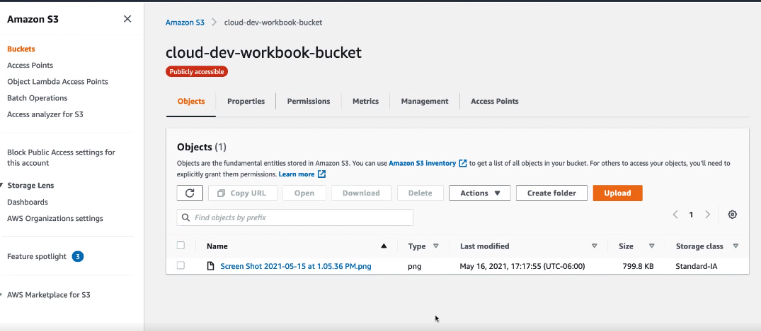

Slide 33
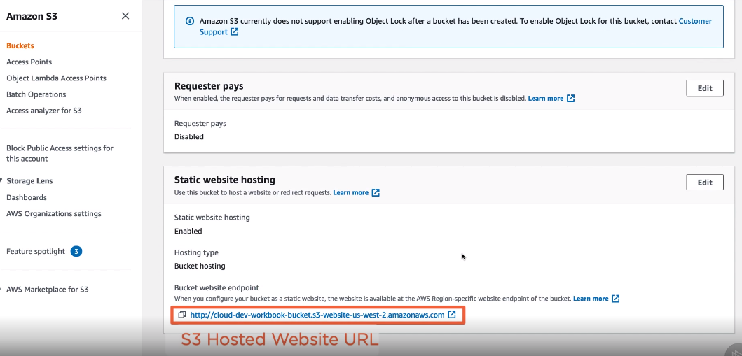

Slide 34
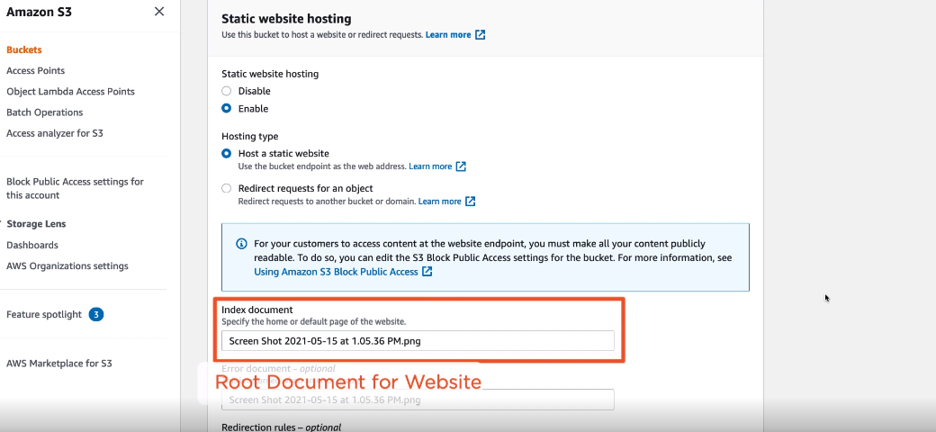

Slide 35

How to Solve Latency in S3
Step 1:
Use CloudFront
Step 2:
Relax!

Slide 36
S3 Pricing Structure
Amount of Data Stored
Number of Requests
Amount of Data Transferred
*Prices diﬀer per region

Slide 37
S3 Oregon Region Pricing Example
Amount of Data Stored
Number of Requests
Amount of Data Transferred
$0.005 USD
per 1,000 Requests
$0.023 USD
per GB
$0.09 USD
per GB
*** Please see https://aws.amazon.com/s3/pricing/ for current pricing

Slide 38
Relational Database Service

Slide 39

Relational Database Service (RDS)
The solution for your database needs

Slide 40
Managed Database Aspects
Scheduled automated backups
Simple software updates Managed infrastructure

Slide 41
Database on EC2 vs. RDS
Database backups
AWS handles it all
+
Redundancy
Easy configuration
Software patches
Read replicas

Slide 42






RDS Database Options

Slide 43


RDS Databases Run on EC2 Instances

Slide 44
…but having Amazon manage the database for you will save you headaches
Yes, you can install a database with EC2 on your own…

Slide 45
RDS Makes It Easy to…
Take DB Snapshots
Change the Hardware

Slide 46
AWS Takes Security Seriously

Slide 47






EC2
RDS
Instance
Security Group
User
External Application

Slide 48
RDS Pricing Structure
Type of Database
Region
EC2 Instance Type

Slide 49
RDS Pricing Example
MySQL Database
$0.35 USD
per hour
Oregon Region
$8.40 USD
per day
db.m4.xlarge Instance
*** Please see https://aws.amazon.com/rds/pricing/ for current pricing

Slide 50
Pricing changes based on the database type

Slide 51
Other Managed Database Offerings from Amazon
DynamoDB
NoSQL Database
DocumentDB MongoDB-compatible NoSQL Database

Slide 52
Route53

Slide 53

Route53
The solution for your DNS needs

Slide 54
Domain Name System
System that translates human-readable URLs to IP addresses

Slide 55


www.example.com
EC2
Application

Slide 56
Route53 is Core to letting users interact with services in AWS

Slide 57
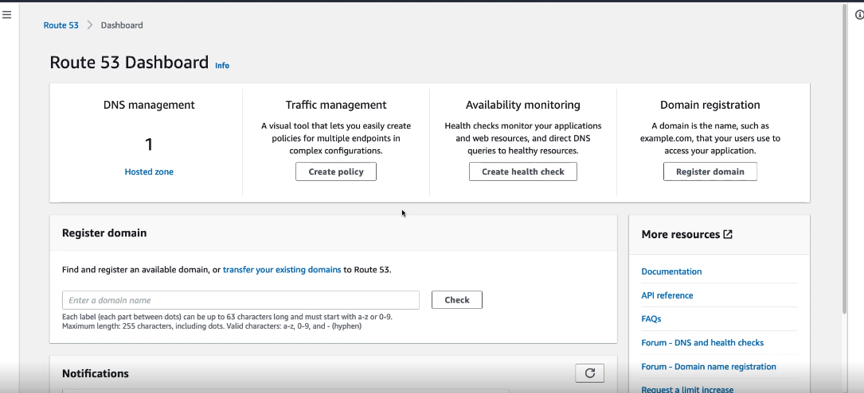

Slide 58
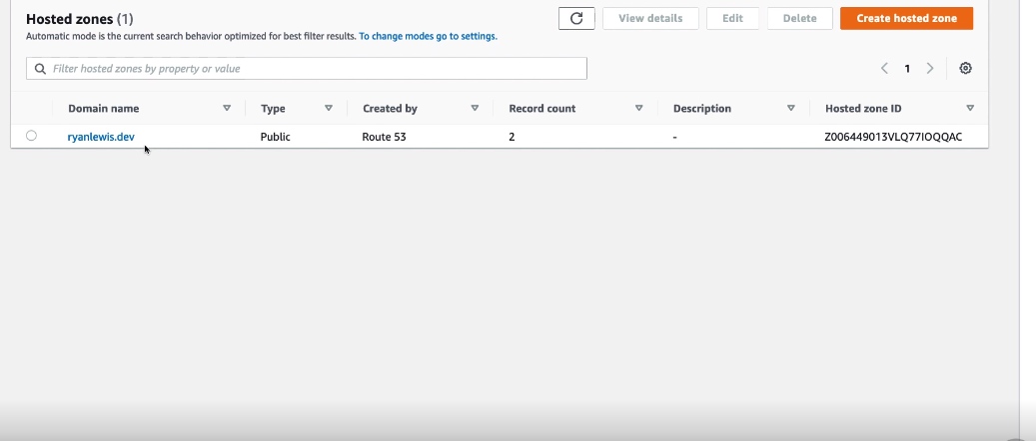

Slide 59
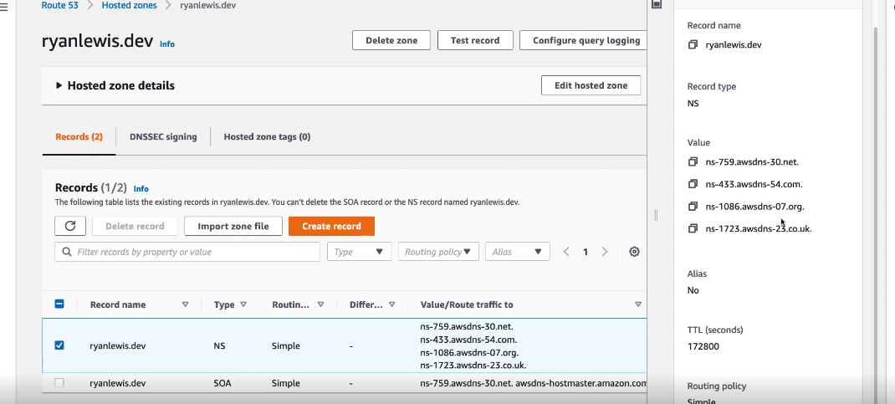

Slide 60
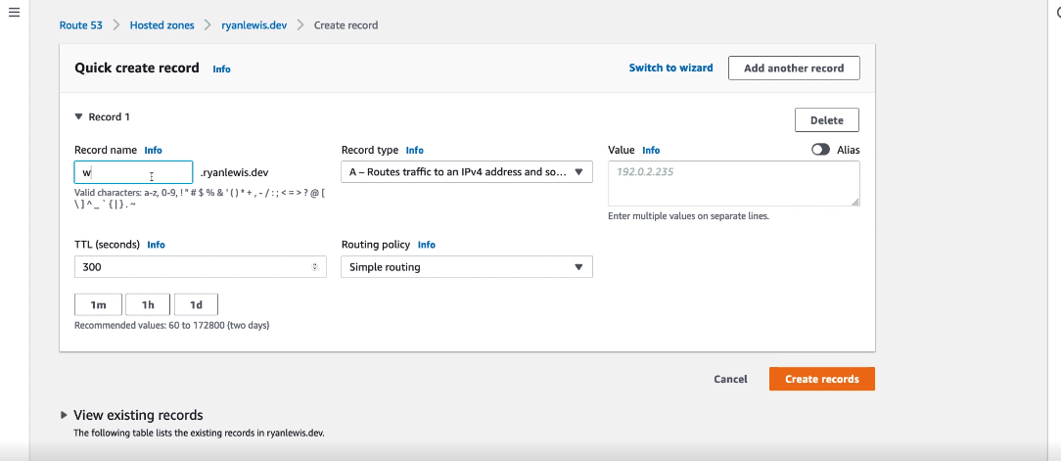

Slide 61
Route53 Pricing Structure
Hosted Zone
Queries
DNS Entries
$0.50 USD
per month
$0.40 USD
per 1M
Free
*** Please see https://aws.amazon.com/route53/pricing/ for current pricing

Slide 62


Route53 Health Checks
example.com
503
200
200

Slide 63
Conclusion

Slide 64
Summary
EC2 for computing
S3 for storage RDS for databases Route53 for URLs

Slide 65
Enhancing Your App with AWS Databases and Application Services

Slide 66






AWS Extended Services
EB
Lambda
DynamoDB
VPC
CloudFront
CloudWatch

